Slide 1

Pitch Angle Isotropy of Relativistic Electron Microbursts as Observed by SAMPEX/HILT: Statistical and Storm-time Properties
Presented by:
Conrad Meyer-Reed
Co-authors:
Lauren Blum, Mike Shumko

Slide 2
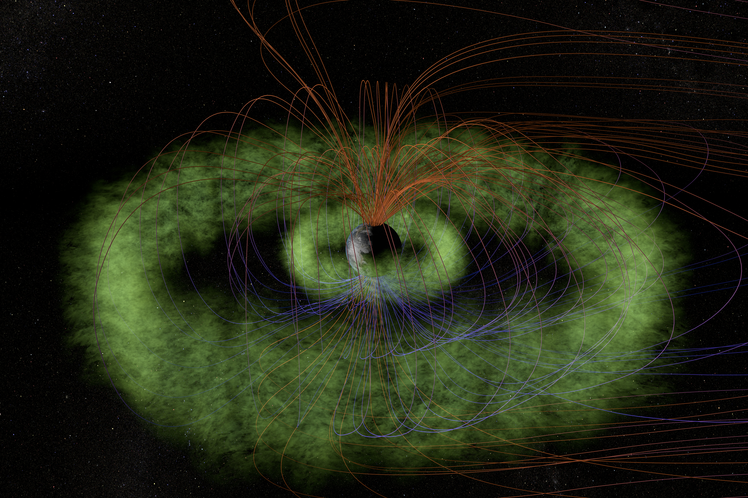
Outline
Introduction
Statistical Study
Storm-time Analysis
Conclusions
(From T. Benesch and J. Carns)

Slide 3
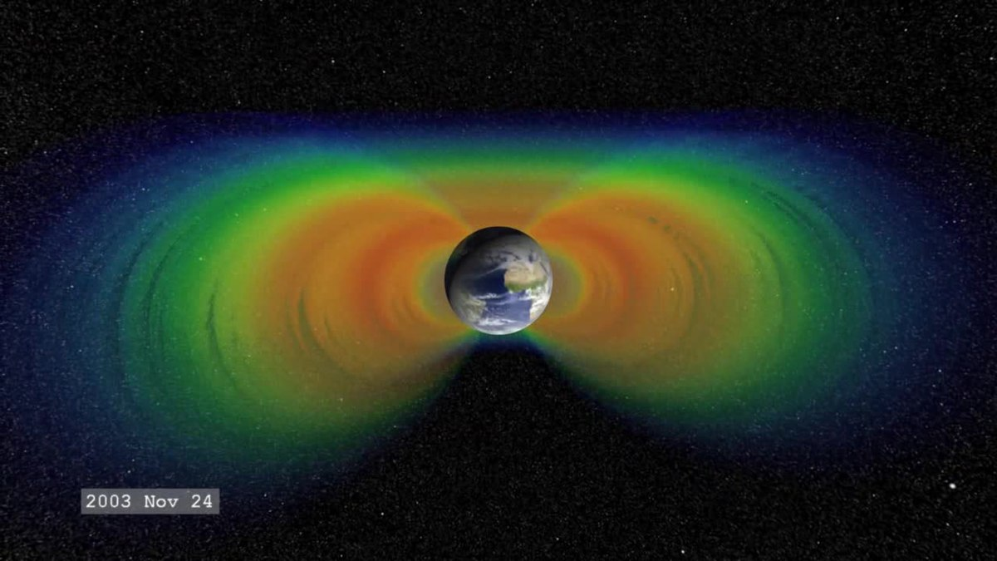
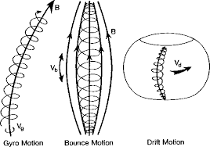
Introduction
The Earth’s radiation belts are composed of electrons interacting with the planetary magnetic field in 3 main motions:
Gyro motion (~1 ms)
Bounce motion (~0.1-1.0 s)
Drift motion (~1-10 min)
(From Wikipedia)
Electron bounce motion is the result of the Lorentz force accelerating electrons away from high latitude polar regions
Mirror point: point at which an electron reverses direction and bounces back toward the equatorial region
(From Yuting Ng, 2013)

Slide 4
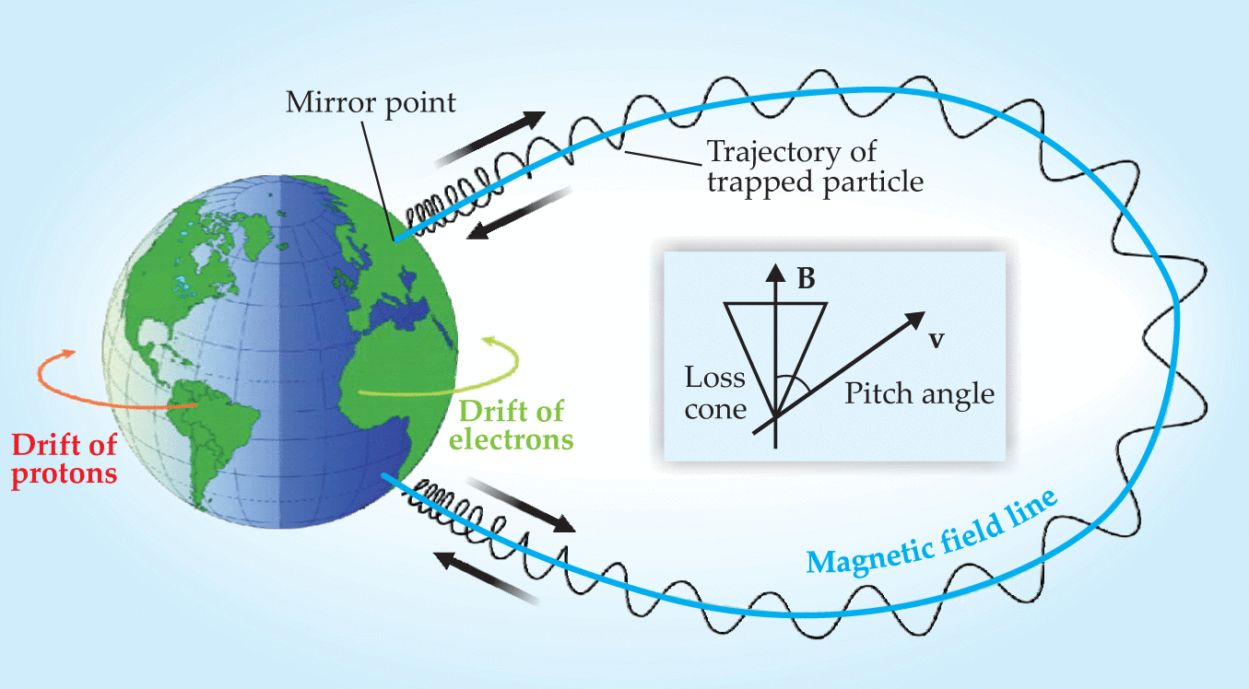
Introduction
Electrons with mirror points below an altitude of ~100km will precipitate into the upper atmosphere
Electrons interact with molecules in the upper atmosphere before bouncing
Pitch angle (α): angle between the velocity vector of an electron and the local magnetic field line
Bounce loss cone (BLC): range of equatorial pitch angles that would result in electron precipitation
(From Day, 2008)
J. Sample, PhD Thesis (2013)

Slide 5
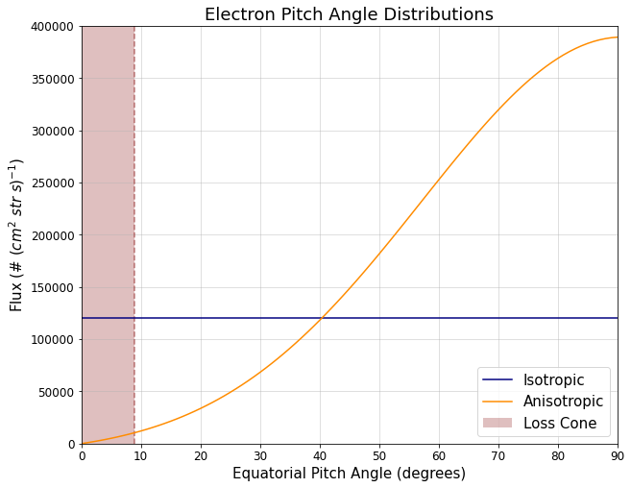
Introduction
Pitch angle isotropy is defined by how an electron population’s pitch angles are distributed:
Anisotropic: Pitch angles are pointed unevenly
Isotropic: Pitch angles are pointed everywhere equally
In a typical anisotropic distribution, the BLC is empty (less precipitation)
In a typical isotropic distribution, the BLC is full (more precipitation)
Why do we care?
J. Sample, PhD Thesis (2013)

Slide 6
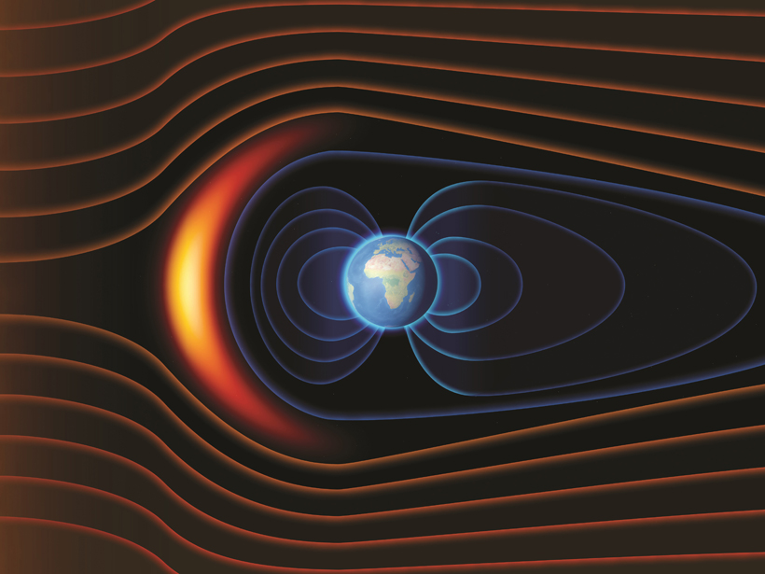

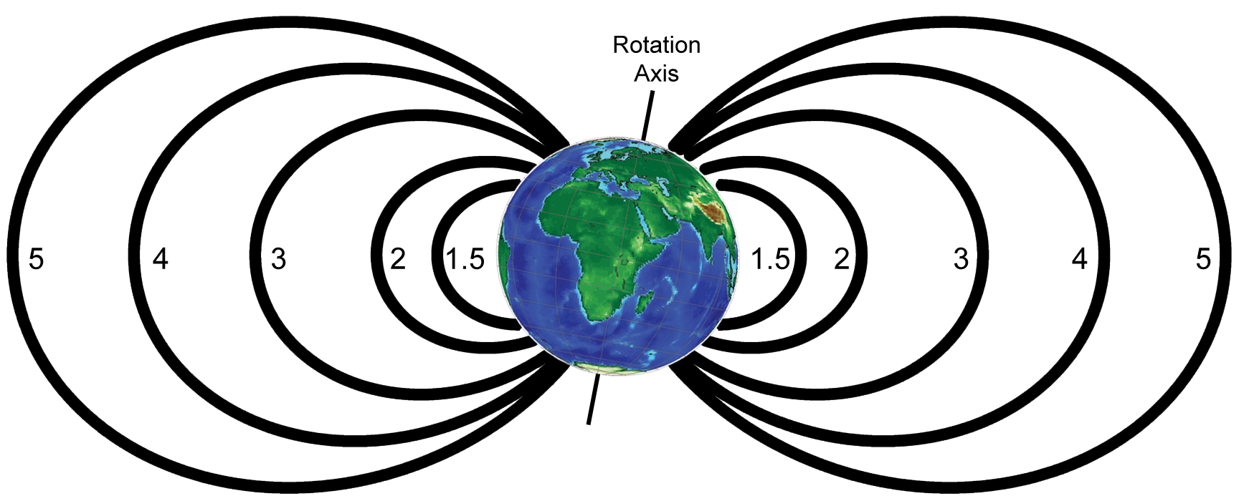
Introduction
MLT
6
Magnetic local time (MLT): magnetic longitude coordinates independent of Earth’s spin
L-Shell: magnetic field lines which cross the equator at a distance measured in Earth radii equal to the L-value
12
0
18
(From Eos.org)
L-Shell
(From Wikipedia)

Slide 7
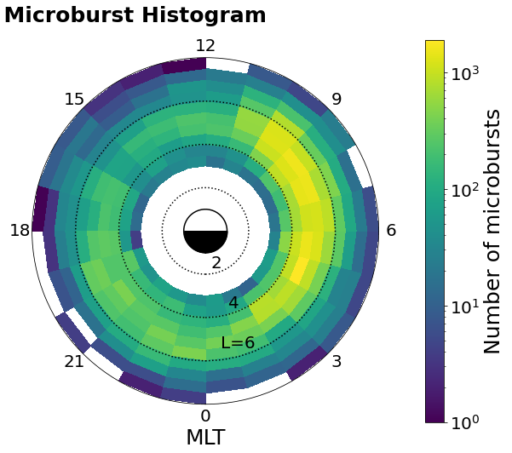
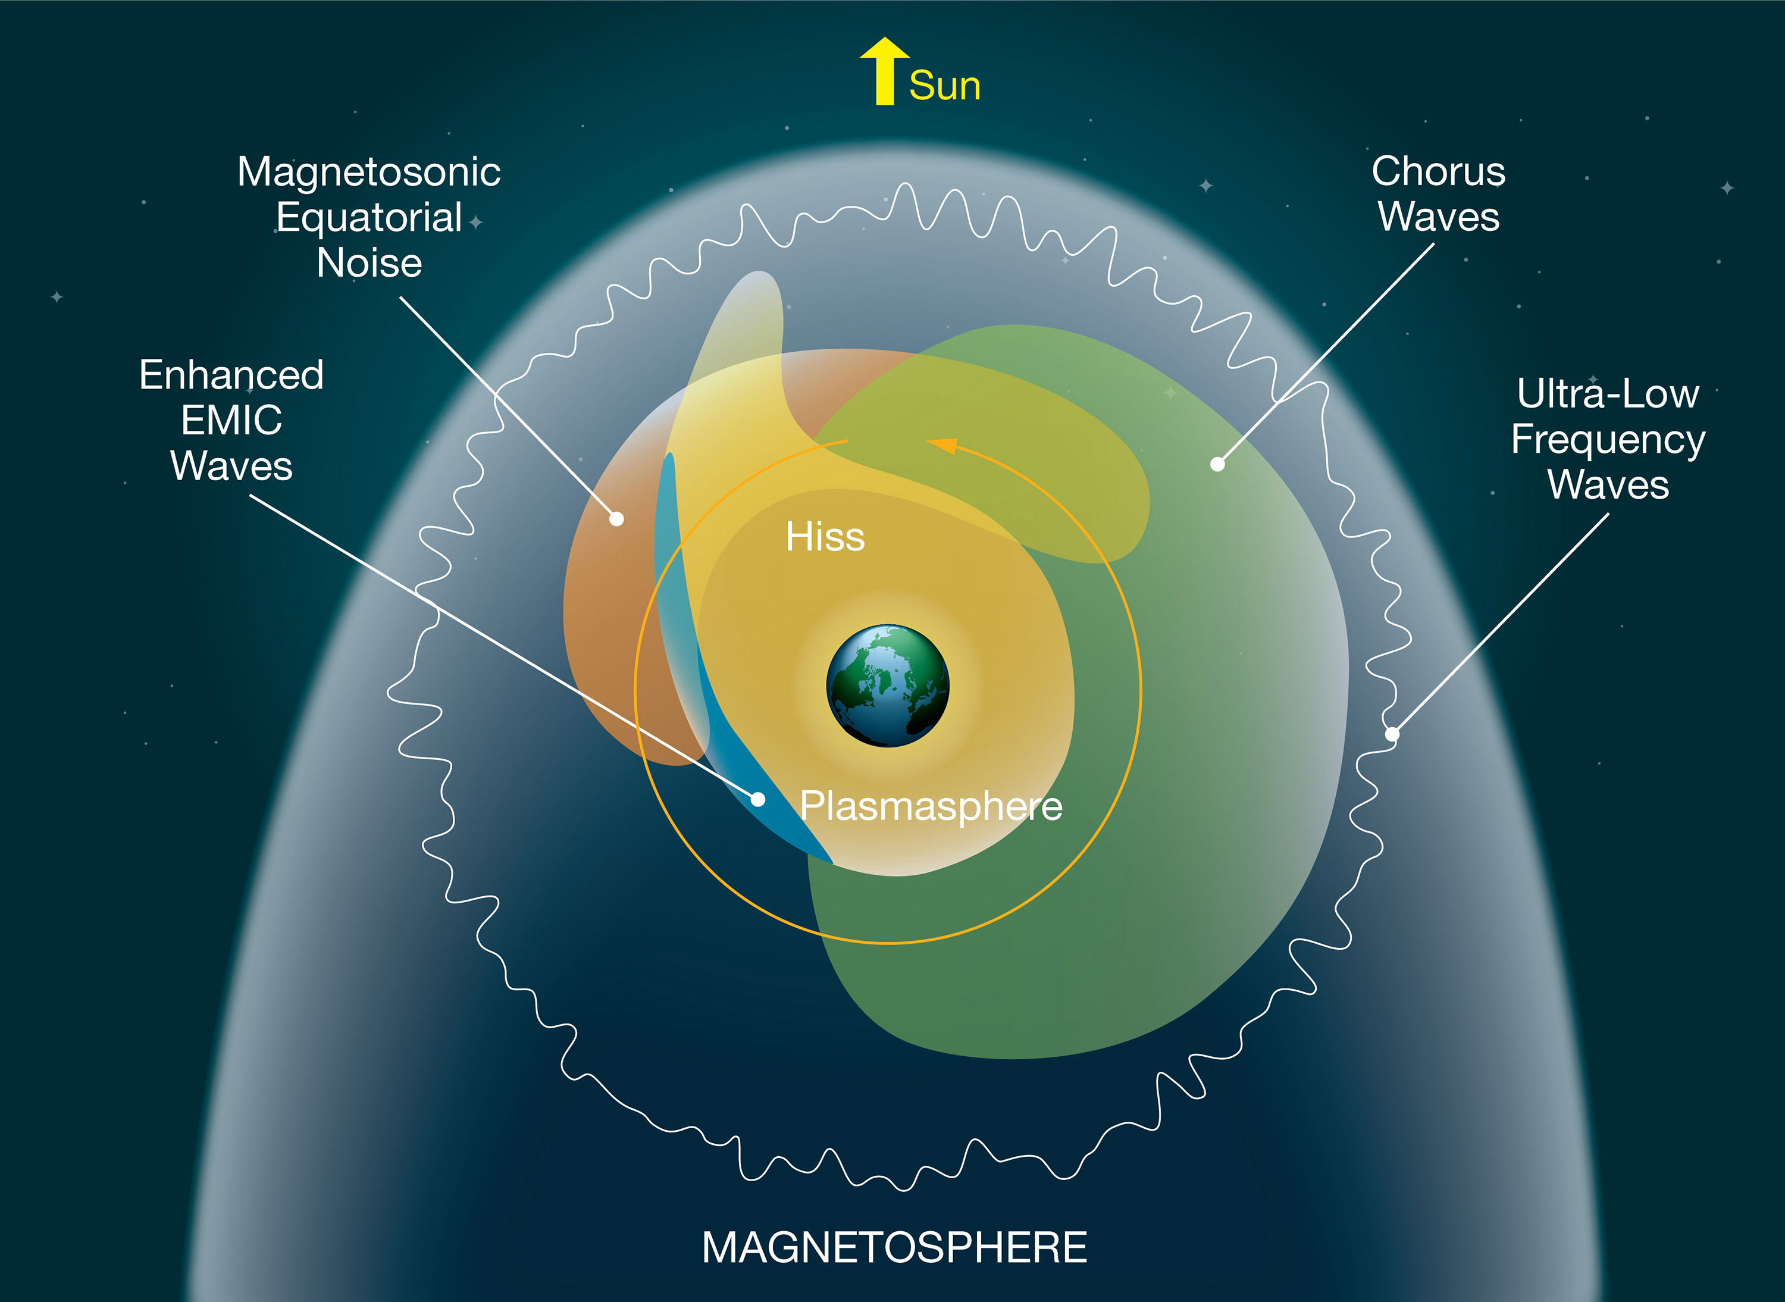
Introduction
Microbursts:
<1s duration streams of MeV-energy electrons often observed in the sub-auroral regions of the inner magnetosphere
Microbursts are pitch angle scattering mechanisms that fill the BLC and cause electron precipitation
Microbursts have been previously associated with chorus wave activity in the morning magnetic local time (MLT) region
(From NASA)

Slide 8
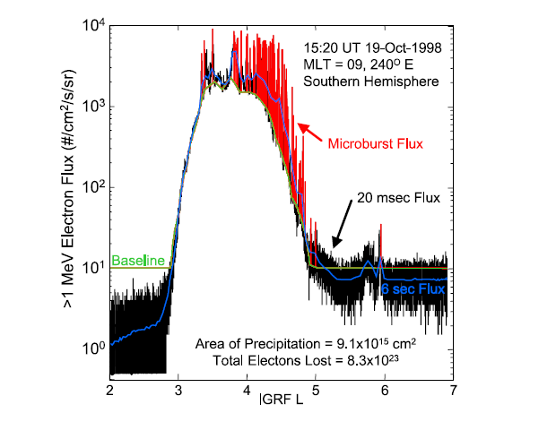
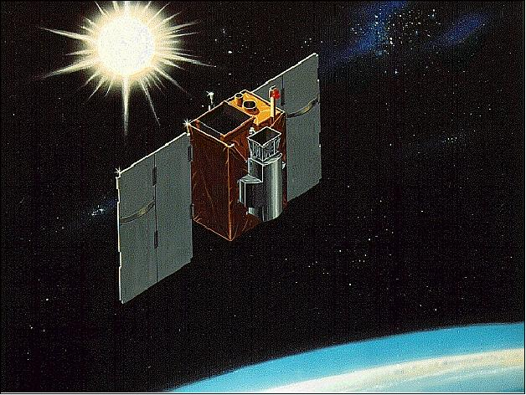

Introduction
SAMPEX satellite collected information about particles in the Earth’s radiation belts in near-polar orbit from 1992-2012
HILT instrument onboard SAMPEX measured relativistic electron flux in Earth’s radiation belts
(From O’Brien et al, 2004)
The high cadence (100ms time resolution) measurements of HILT allowed for the observation of microbursts using the following detection algorithm:
(From O’Brien et al, 2003)
(From eoPortal Directory)

Slide 9
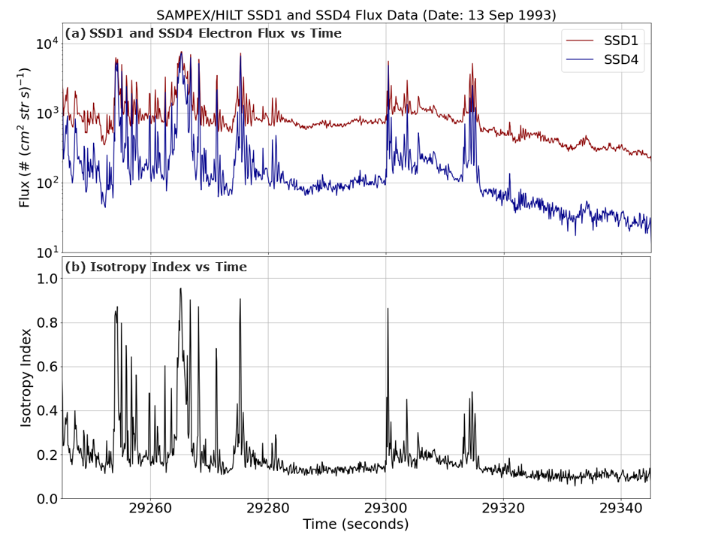
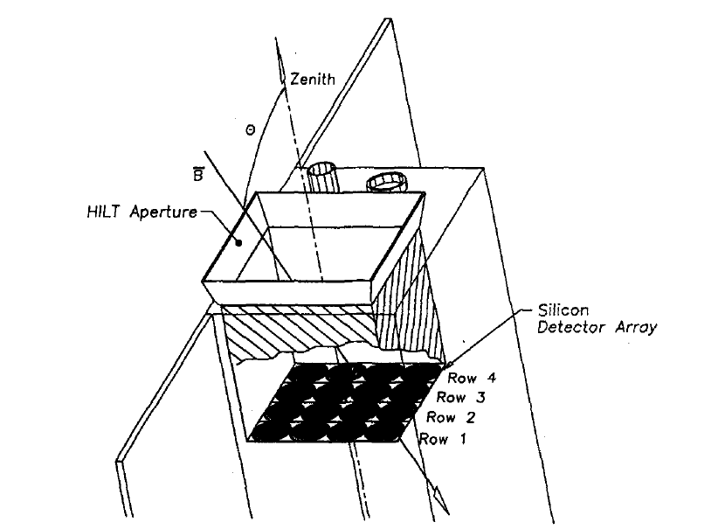
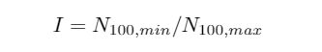
Introduction
HILT instrument onboard the SAMPEX satellite consisted of a 4x4 Silicon detector array that recorded >1 MeV electron counts
Microburst
Background
Ratio of electron counts from detector rows 1 and 4 gives pitch angle isotropy:
Isotropy index = 0 -> Anisotropic
Isotropy index = 1 -> Isotropic
Isotropy index calculation:
(From Blake et al, 1996)

Slide 10
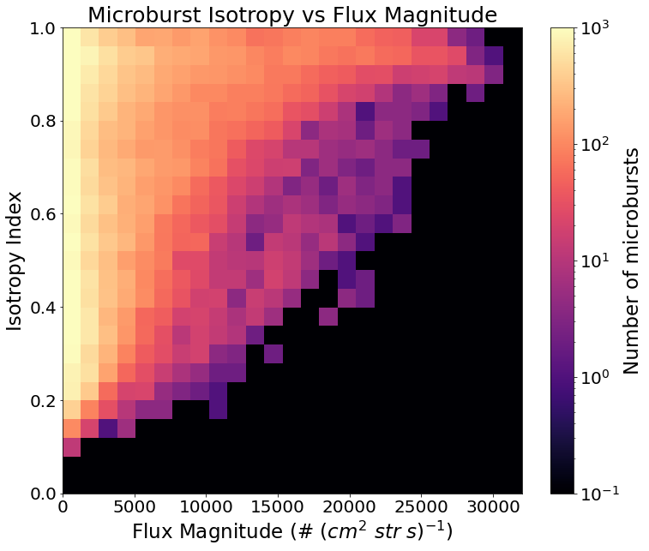
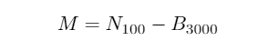
Statistical Study (Part 1)
Methods:
SAMPEX electron counts data selected from the year 1993
Analysis of correlations between microburst isotropy index and flux magnitude
Microburst flux magnitude calculation:
Results:
Most microbursts are low flux magnitude
Positive correlation between isotropy index and flux magnitude:
Low magnitude: 0.1 – 1 isotropy index
High magnitude: ~1 isotropy index
(From O’Brien et al, 2003)
Figure 1

Slide 11
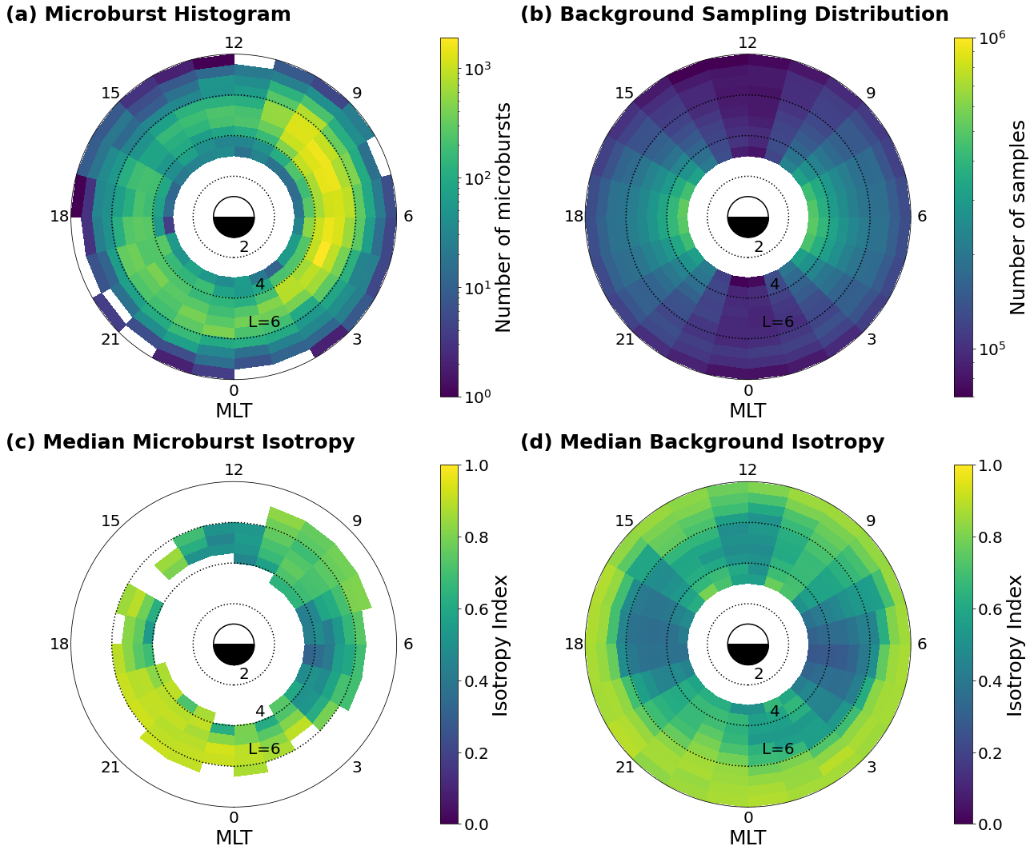
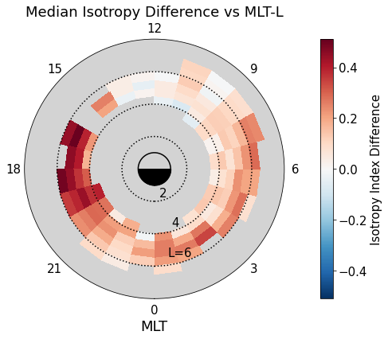
Statistical Study (Part 2)
Methods:
SAMPEX electron counts data selected from the year 1993
Analysis of correlations between microburst isotropy index and MLT-L coordinates
Results:
High relative microburst isotropy in the evening MLT region, medium isotropy at midnight/morning, and low isotropy at noon
Figure 2
Figure 3

Slide 12
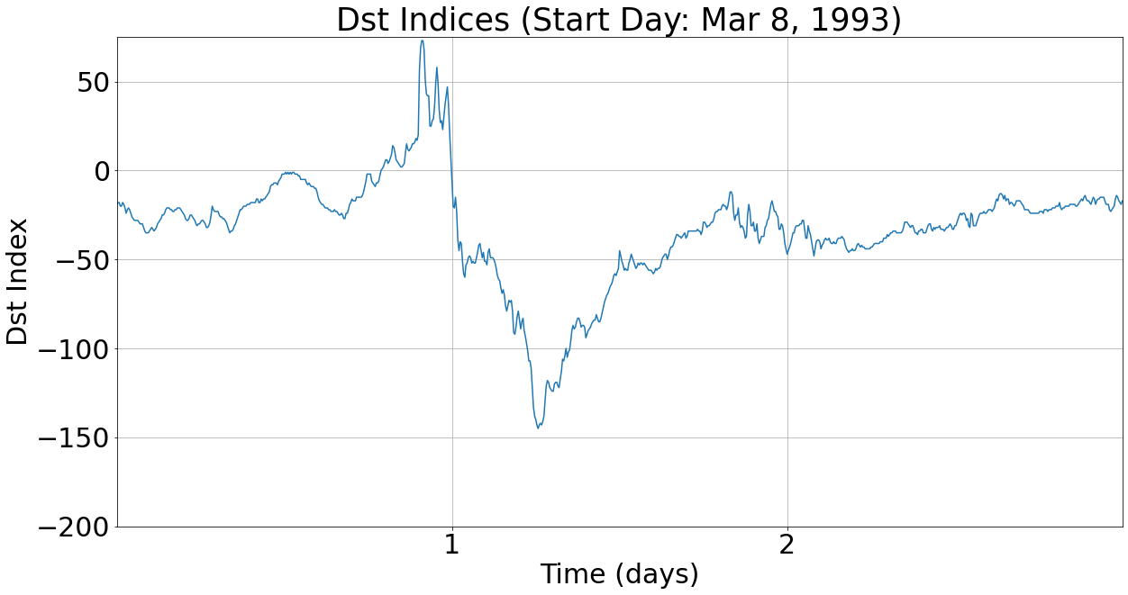
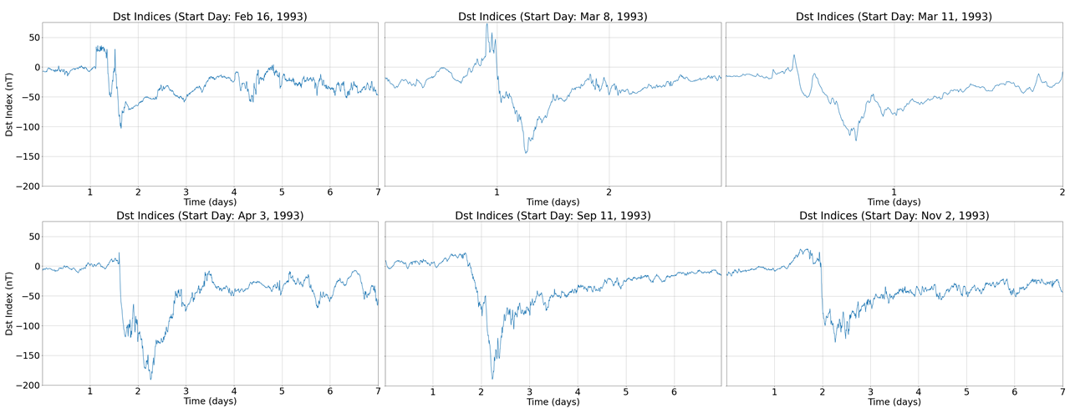
Storm-time Analysis
Methods:
Out of the 9 geomagnetic storms from 1993 with Dst_{min} < -100 nT, 6 storms with typical Dst profiles were selected for our analysis
Analysis of storm-time dependence of median microburst isotropy for initial, main, and recovery phases of storms
Initial
Main
Recovery
Dst: Disturbance storm-time index
Figure 4

Slide 13
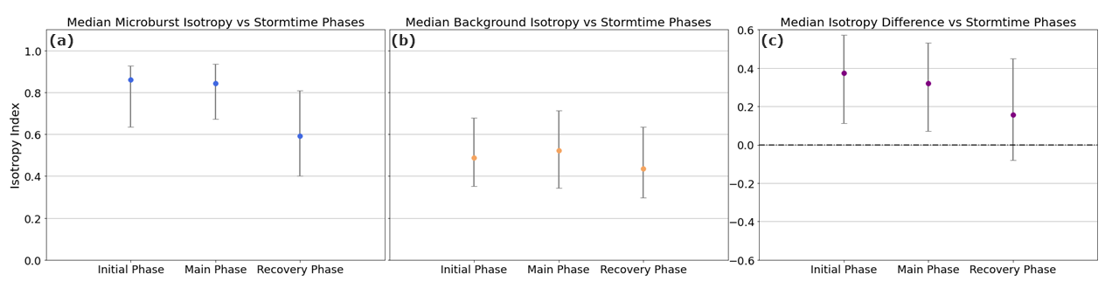
Storm-time Analysis
Results:
Highest relative microburst isotropy in the initial phase of intense geomagnetic storms (error bars show 25th and 75th percentiles)
Negative trend in relative microburst isotropy can be seen as storm phases progress
Figure 5

Slide 14
Summary
High isotropy corresponds to more electron precipitation; low isotropy corresponds to less electron precipitation
Low flux magnitude microbursts are widely varying in isotropy; high flux magnitude microbursts are more isotropic
Relative microburst isotropy is highest in the evening magnetic local time region and lowest in the noon region
Relative microburst isotropy is highest during the initial phase and lowest during the recovery phase of intense geomagnetic storms
Lastly, it is important to note that microburst isotropy was higher than the background in each section of the study

Slide 15
Acknowledgements
Many thanks to:
Professor Lauren Blum for mentoring me throughout my time researching at LASP
Mike Shumko for providing feedback about my research and helping me with any coding questions I had
Contact information:
Email: Conrad.Meyer-reed@colorado.edu
Cell: (574) 538-8023

Slide 16
Discussion
First study showing the correlation between microburst isotropy and flux magnitude
Microburst isotropy depends strongly on MLT; less dependence on L-Shell
High isotropy microbursts in the evening MLT region could be linked to EMIC wave activity
Results showing highest microburst isotropy during the initial phase of intense geomagnetic storms do not fully agree with past studies; could be storm intensity related
Lastly, it is important to note that microburst isotropy was higher than the background in each section of the study

